Slide 1
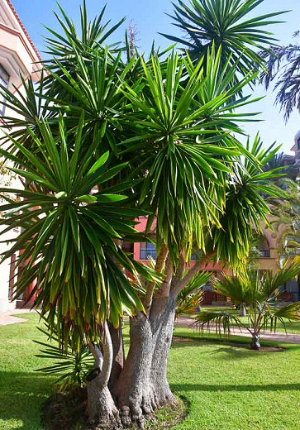
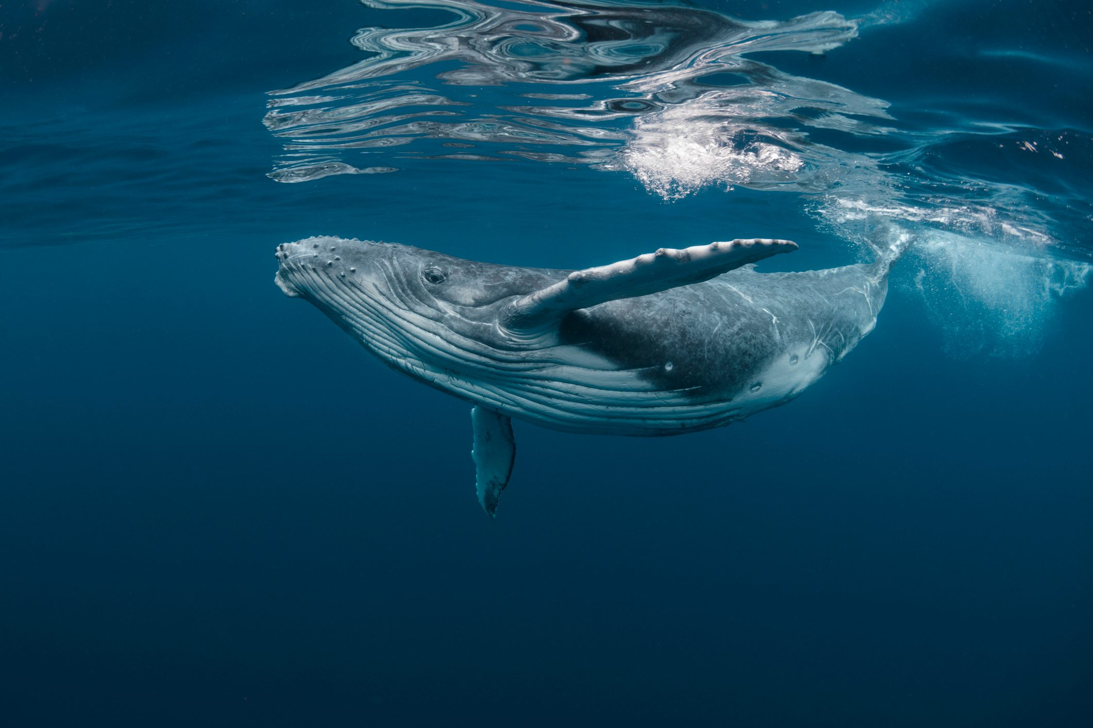
5th Will I Survive? 2022-2023 Physical Adaptations: Set 1
Plant: Yucca
If you made a list of the environments most conducive to sustaining plant life, the desert would likely be near the end of your list. The desert is an extremely hot and harsh environment with its sweltering midday heat and dry, moisture-less atmosphere. Very few can call the desert home due to the ruthless conditions, but Yucca is one of the few that thrives in this unforgiving environment. Yucca is astoundingly effective at retaining water and holding onto it for long periods of time, making it one of the hardiest and drought- resistant plants in the world. They are specifically adapted to desert climates and will die from overwatering. Part of what makes Yucca so successful in its dry habitat is its root structure. Yucca roots are shallow and sprawling so they can quickly and effectively absorb every drop of water that becomes available. With its sword-like leaves and spiny shrub-like appearance, Yucca is an unmistakable icon of the North and South American deserts, and are known for their ability to survive intense drought conditions. Like cacti and other desert plants, Yuccas have sharp, dagger-like leaves. These sharp leaves are adaptations that help to protect the plant’s water reserves from thirsty animals wandering the desert. Source: https://www.ambius.com/blog/the-secrets-of-the-survivalist-plants/
Animal: Humpback Wale
When you look at a humpback whale what do you notice? You may have noticed its large mouth. There is a special adaptation in the humpback whales' mouths that help them eat. Some whales, like humpback whales, eat by swimming through the water with their mouths open and the water passes through the brush-like structures in their mouth called baleen. The water can pass through the baleen but tiny animals like krill get caught up in the baleen for the whale to eat. Whales that don't have baleen instead have teeth in their mouths and eat different things like fish. For the whale's blowhole, this is an adaptation that all whales and dolphins share that help them breathe. The blowhole is on top of the animal's head and is connected to their lungs. When whales eat the water that goes into their mouth can't go into their lungs, so there's less risk of drowning. Whales are also able to actively control when they need to breathe by opening or plugging their blowhole. This helps them stay in the water for usually five to fifteen minutes. Source: https://naturalhistory.si.edu/education/teaching-resources/life-science/explore-animal-adaptations

Slide 2
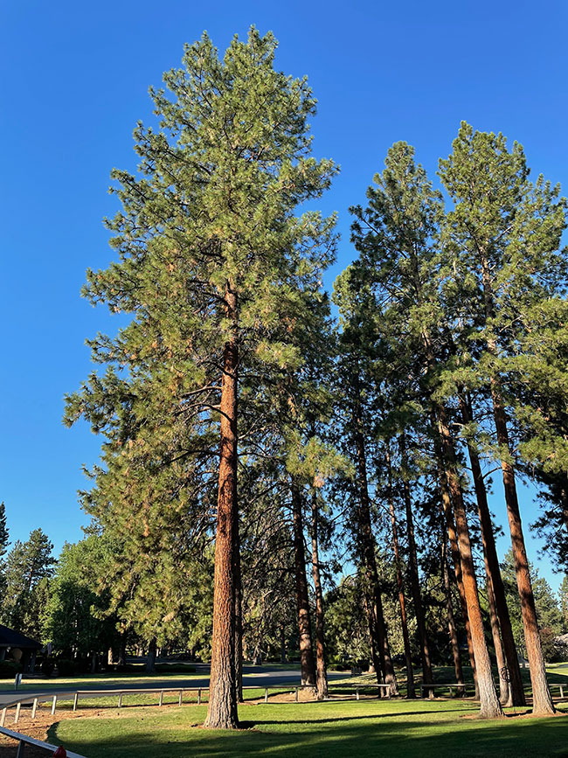
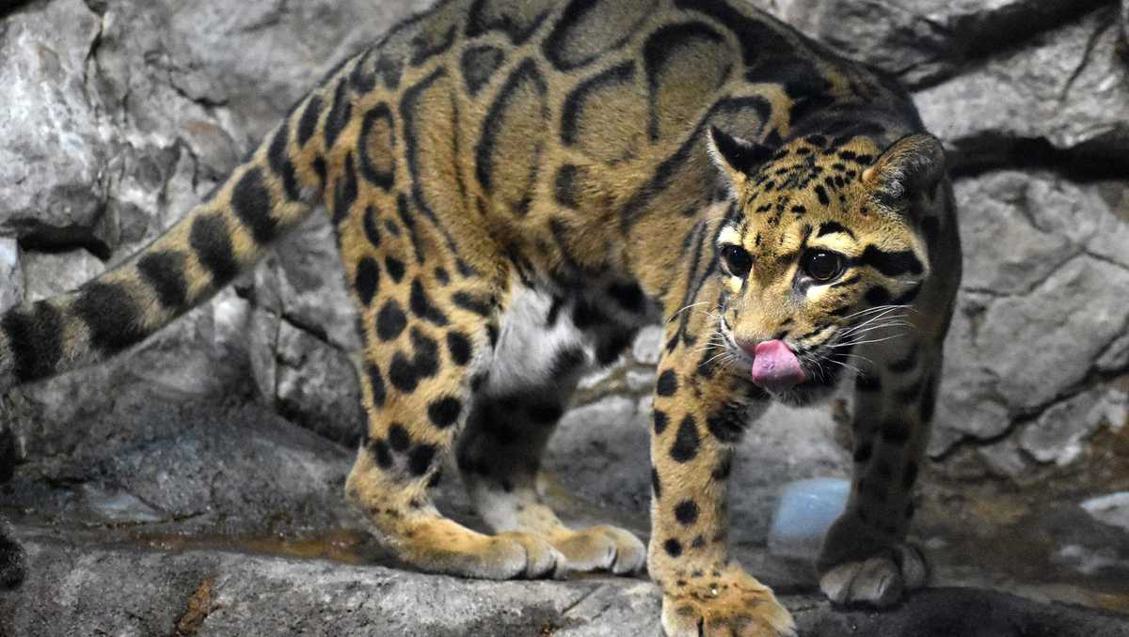
5th Will I Survive? 2022-2023 Physical Adaptations: Set 2
Plant: Ponderosa Pine
They say if you play with fire, you get burned. This is only partially true of the Ponderosa Pine, a species of evergreen tree that is resistant to fire. When confronted with fire, most trees have no defense and are easily burned, but the Ponderosa Pine is different than most trees in that it’s adapted to its environment and has benefited greatly from it. For thousands of years, the Ponderosa Pine has lived in environments that are prone to fire, most notably the west coast from Washington state to New Mexico, California, and parts of western Canada. These areas are extremely susceptible to wildfires, which led the Ponderosa to grow a thick protective layer of cork-like bark that can stave off the flames. Other fire-resistant adaptations include; deep root system to prevent root damage, exfoliating bark that peels off when on fire, and fire-resistant buds to quickly regrow needles. From an early age, Ponderosa saplings are able to handle low-intensity fires and the more they mature, the more effective they become at surviving low and moderate-intensity fires. In fact, the trees actually benefit from their environments catching on fire as it replenishes the soil with nutrients to help the trees grow. It also prevents a buildup of bark and “mulch” from the base of trees that accumulate and when burned during a fire, can harm the tree by smoldering for days, preventing the tree from healing properly. It’s strange, but this tree has developed a symbiotic relationship with one of its species most notorious adversaries. Source: https://www.ambius.com/blog/the-secrets-of-the-survivalist-plants/
Animal: Clouded Leopard
Let’s take a look at the clouded leopard and start with the legs. Looking at the legs of the clouded leopard, did you notice how short their legs are? Having short legs help the leopard stay close to the surface it is on, which increases their balance. Their big paws help the clouded leopard have a better grip on things when they move through their habitat. That means it keeps them from slipping. Clouded leopard legs and paws are very special for another reason. They help the cat climb down surfaces head first like a squirrel. The clouded leopard is one of two cat species that can do this. Clouded leopards also have a super long tail. A long tail is an adaptation that helps the animal keep its balance as they climb, jump, walk, and run through their environment. It acts like a counterbalance — the way holding your arms out helps you balance while walking on a balance beam. With short legs and big paws for gripping and climbing down trees, a long strong tail to keep its balance, you may find a clouded leopard living in a forest habitat. It has adaptations that help it move and survive in an environment full of trees. Source: https://naturalhistory.si.edu/education/teaching-resources/life-science/explore-animal-adaptations

Slide 3
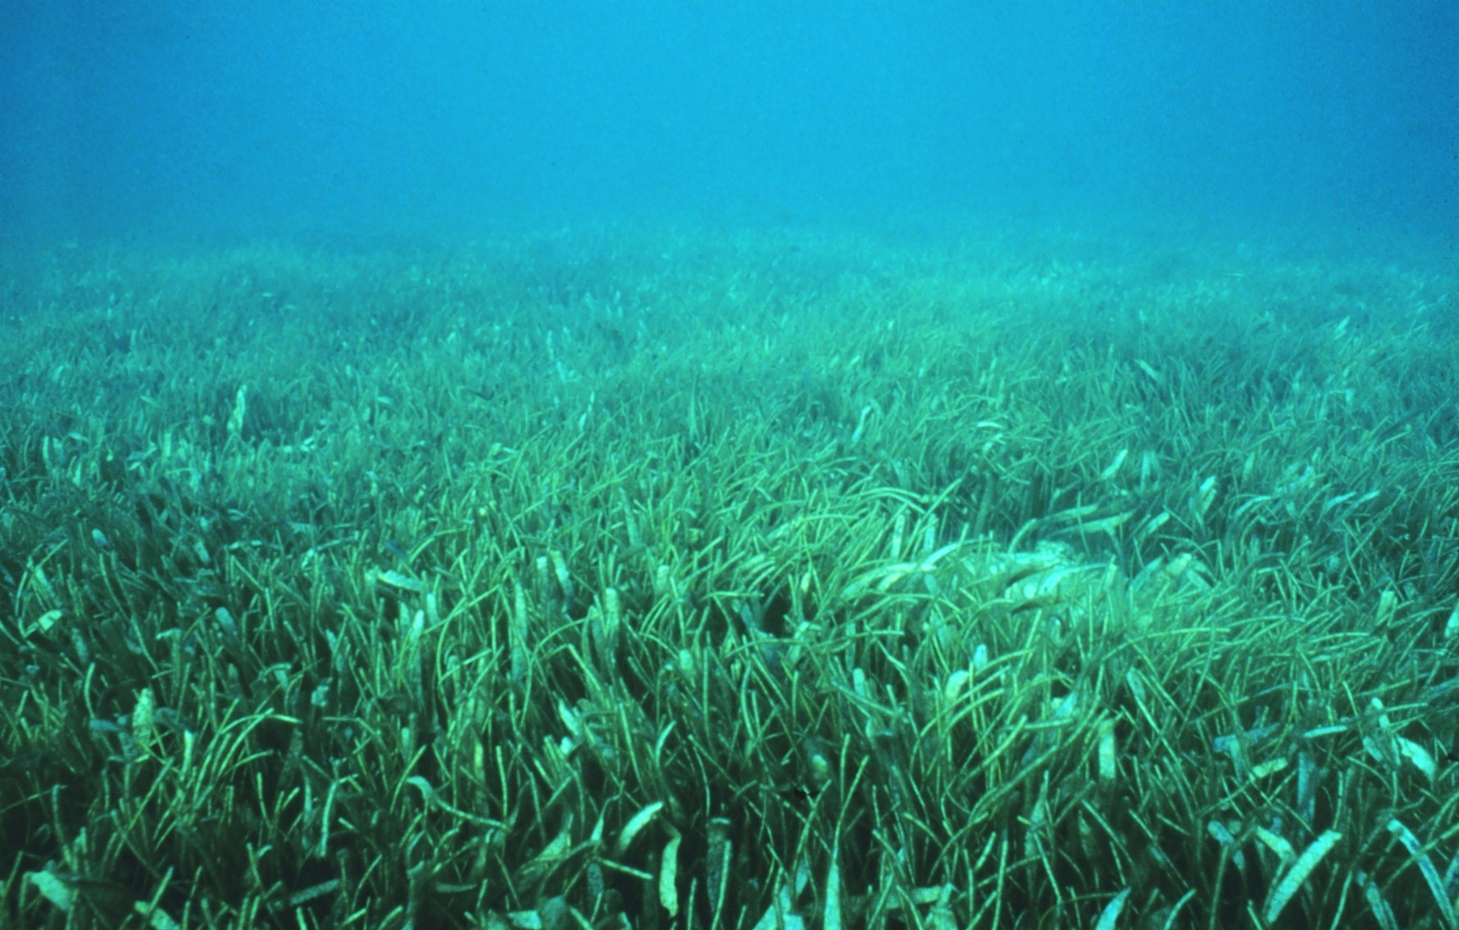
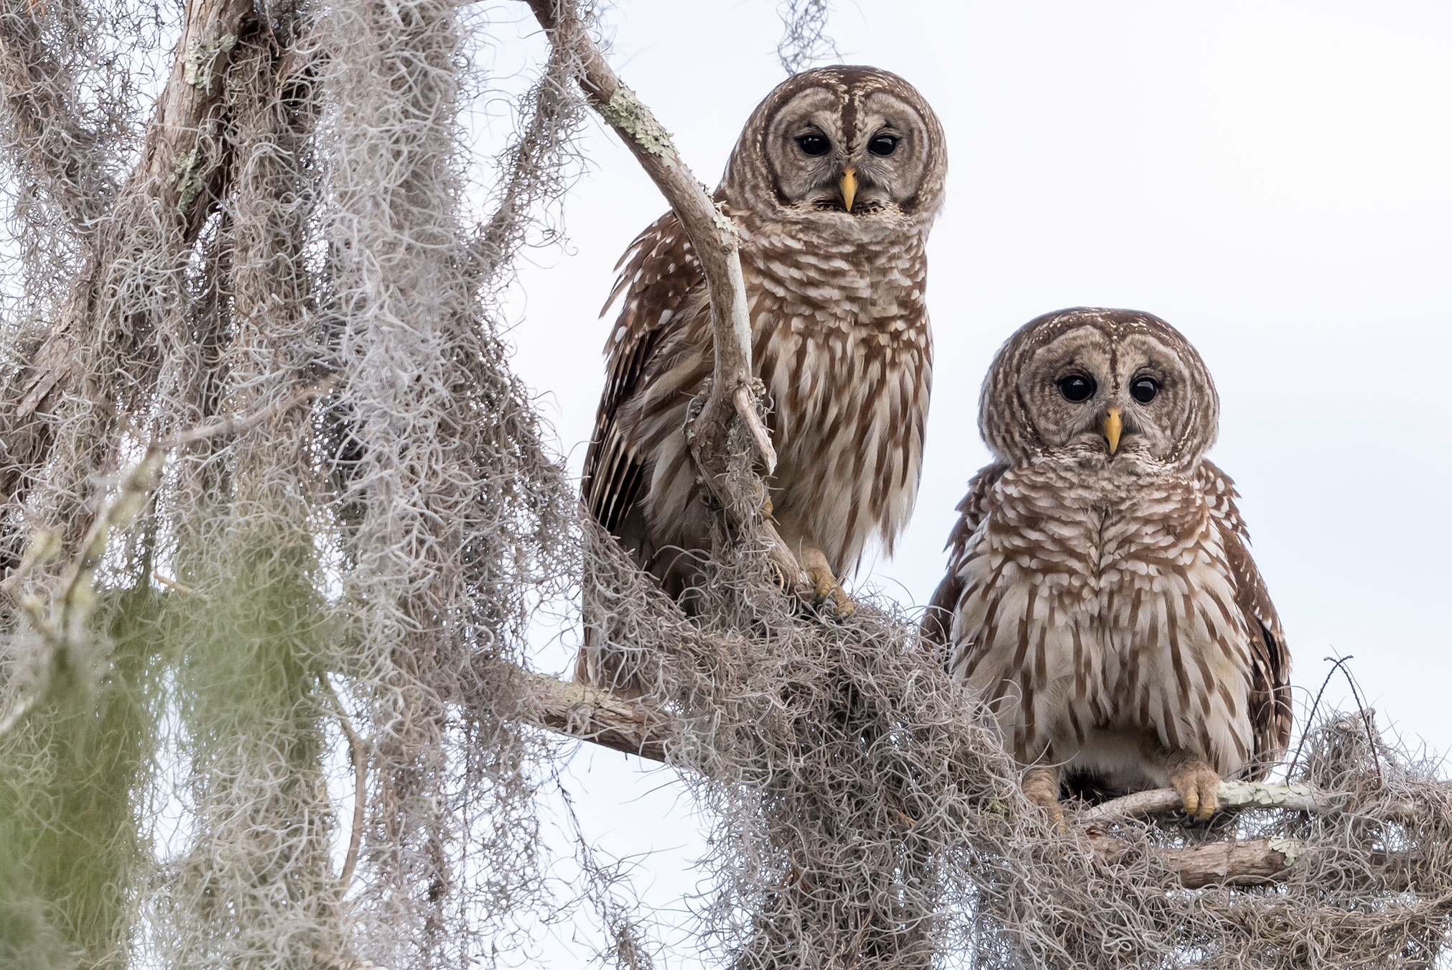
5th Will I Survive? 2022-2023 Physical Adaptations: Set 3
Plant: Seagrass
Plants live in many places, but for the most part, they’re usually above ground where they have ample access to oxygen and sunlight. This is not the case with Seagrasses. Not to be confused with Seaweed, which is actually a type of algae, Seagrass has leaves, roots, and veins just like other plants, except they grow and flower underwater. Despite being anatomically similar to every other plant, Seagrasses have one thing that other plants do not – the ability to grow and thrive while completely submerged under salt or brackish waters. Saltwater kills most plants, but these grasses have adapted to their environments by absorbing nutrients directly from the water through their roots and leaves. Large fields of grassy underwater plains exist all over the world from the tropics to the arctic but are highly concentrated in areas around the Gulf of Mexico, the Philippines, and off the coasts of Australia. These regions are typically bursting with marine life due to the many benefits of seagrass on marine ecosystems such as; one square meter of Seagrass can create 10 liters of oxygen, creates “nursery habitats” that provide shelter for a myriad of marine species, improves water clarity and quality, reduces seafloor erosion, and helps buffer coastlines against hurricanes and coastal storms. Source: https://www.ambius.com/blog/the-secrets-of-the-survivalist-plants/
Animal: Barred Owl
Let's first talk about the wings. The wings of the barred owl, like many birds, are an adaptation that allow it to fly. Flying allows the barred owl to move quickly through the air around its habitat. They also have specialized feathers on the outer parts of their wings that help them make almost no sound when it flies to catch prey. The barred owl, like other owls, has huge eyes compared to the size of its body. The owl's eyes have adapted to see better, especially in low light when the owl is active. Its large eyes are excellent at spotting prey from afar and allow them to fly faster and safer through their environment. The owl's feather pattern is made up of brown and white spots and bars. The bars on its chest are how the barred owl got its name. These markings actually help the owl blend into its environment. You can hardly see it here. This blending in is called camouflage and helps the owl hide from predators and its prey. Source: https://naturalhistory.si.edu/education/teaching-resources/life-science/explore-animal-adaptations

